Slide 1


COMMUNITY SCORECARD
DISAGGREGATED DATA

Slide 2

WHY DISAGGREGATE THE DATA?
By breaking the data down according to distinct groups (disaggregating the data), we can see that there are instances when certain populations are not being well-served.
Disparities related to income, gender and race come to light, and are thereby easier to effectively address. Areas of greatest need are also areas with the greatest potential for impact.

Slide 3
DIGGING DEEPER
Real examples from Dodge and Jefferson Counties demonstrate how the topline data sometimes doesn’t tell the full story. Let’s take a closer look at some indicators that tie directly to the work of our partners.
Adequate Prenatal Care
Third Grade Reading
Depression Rates Among Teens

Slide 4

ADEQUATE PRENATAL CARE
Children and communities thrive when all families have support and resources to provide a safe, stable and supportive environment, prenatal to postpartum and throughout a child’s lifespan.

Slide 5
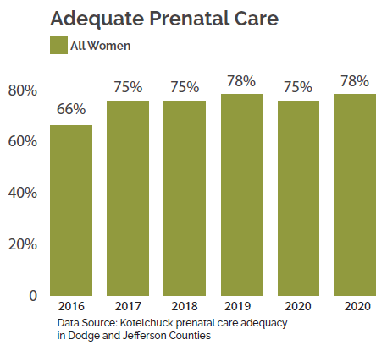
TOPLINE DATA
When we look at the overall picture, it appears that access to adequate prenatal care has remained steady between 75% and 78% since 2017.

Slide 6
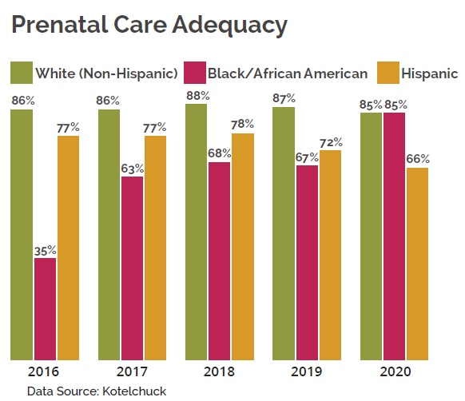
DISAGGREGATED DATA
When we break the data down by race we see a more nuanced picture: Access to adequate care remained stable for White women, improved drastically for Black women, and steadily declined for Hispanic women (from 77% to 66%).

Slide 7

THIRD GRADE READING
Without a strong foundation in reading, children are left behind at the beginning of their education.

Slide 8
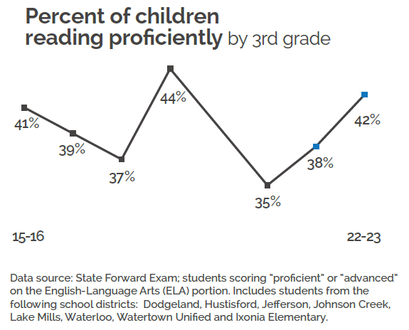
TOPLINE DATA
When we look at the overall picture, reading proficiency dipped to 35% following the COVID pandemic, and is slowly rebounding.

Slide 9
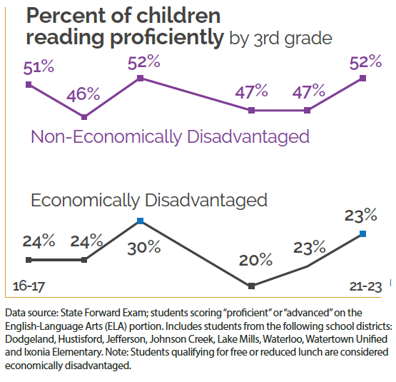
DISAGGREGATED DATA
When break the data down by income, a significantly different picture emerges. What are the challenges contributing to this outcome? How is the system as a whole working for one group, but not another (equally large or larger) group of students?

Slide 10
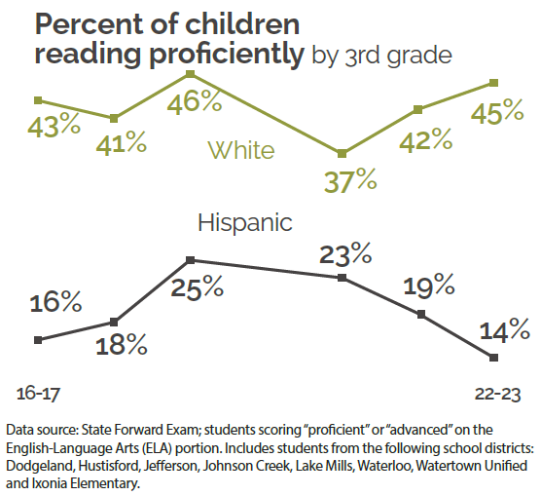
DISAGGREGATED DATA
When we parse the data yet another way - by race - we see another story. One that allows us to ask fruitful questions about how Hispanic youth are being served by the current system, and how we might design interventions for success.

Slide 11

DEPRESSION RATES AMONG TEENS
Children with strong social-emotional skills are more likely to graduate high school, complete a college degree and obtain stable employment.

Slide 12
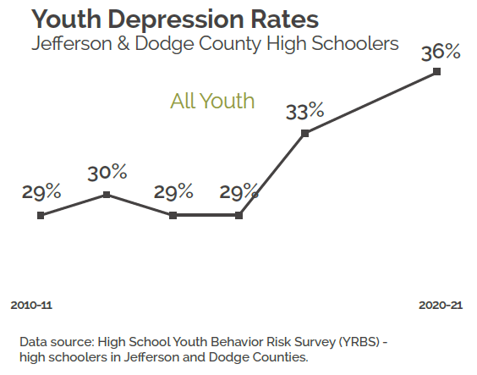
TOPLINE DATA
When we look at the overall picture, depression is on the rise among teens.

Slide 13
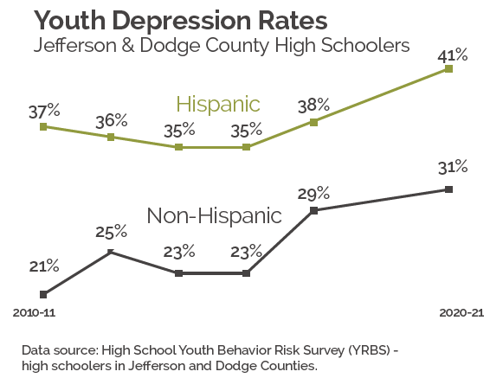
DISAGGREGATED DATA
When we look at the data by race, we see that rates of depression are consistently higher among Hispanic youth - pre-and post-pandemic. This is another opportunity to ask why, and how can this population be better served by our systems?

